Slide 1
Accessing data files on Cloud Object Storage
Hands-on Workshop
Stephen Foerster
Data Engineering Lead, SAS Education

Slide 2

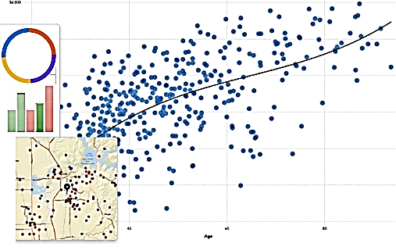
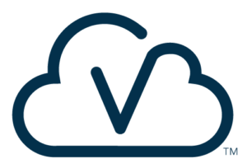





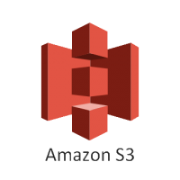
Visual Analytics
Azure Blob Storage
SAS Studio
Google Cloud Storage
Compute Server
CAS Server
SAS Enterprise Guide
Amazon S3
Notes:
SAS has too many different object storage access technologies to cover all of them here.
Technology-specific features like PROC S3 will be skipped in order to focus on more general strategies like library engines and DuckDB integration.

Slide 3
Object Storage Access
Notes:
As a central part of our SAS data lake strategy, accessing object storage files is especially important.
On the left is Viya and on the right an object storage container or bucket.
SAS has several different strategies for accessing files on object storage.

Slide 4
Object Storage Access
Azure Blob
AWS S3
Google Cloud
…
Many Different Implementations
Notes:
Object storage encompasses many implementations including S3, Azure blob storage, Google cloud storage, and even open-source distributions like MinIO and Garage.
SAS can read and write files from all these platforms.
The access methods depend on the object storage implementation as well as the file type.
Open-source object storage tends to track very tightly with S3. So, strategies and SAS capabilities that work on S3 also tend to work with them.

Slide 5
Object Storage Access
Azure Blob
AWS S3
Google Cloud
…
Different File Types
JSON
XML
CSV
SAS7BDAT
PARQUET
ORC
Image
…
Notes:
Object storage can hold any data file type including JSON, XML, CSV, SAS datasets, parquet, orc, images files, and so forth.
There are access strategies that work with all file types and all object storage implementations like using PROC HTTP.
There are also strategies that only work with specific file types and/or specific implementations like the ORC Libname engine.

Slide 6
Direct Access via PVC Mount
Azure Blob
AWS S3
Google Cloud
…
libname …;
Mountpoint for Amazon S3
AZNFS for Azure Blob Storage
Google Cloud Storage FUSE
*.*
JSON
XML
CSV
SAS7BDAT
PARQUET
ORC
Image
…
Notes:
For some file types like its own native SAS datasets, SAS requires a POSIX-compliant file system to achieve the full functionality of the SAS Compute Server and CAS. Think of the different ways SAS can access SAS datasets, in sequence, random access (DATA Step POINT option), subset (WHERE option), via index (KEY option, and even for modification in place (MODIFY statement).
Object storage does not provide POSIX file system APIs, by design. Object storage provides REST APIs for reads, writes, and other actions.
However, each major object storage vendor, alongside a host of 3rd party and open-source options, now provides tools that translate the native object storage REST API calls into POSIX API calls.
So, files on object storage can now be fully utilized by SAS as traditional Linux files.
Considerations and methods can be found within several SAS Communities posts as well as the cloud platform’s documentation.
Once mounted, object storage files will be accessible like local Linux files, with higher latency of course.
See Viya’s V9 Engine and CAS Path Data Source documentation for the current list of local file types available and thus on object storage through these mechanisms.

Slide 7
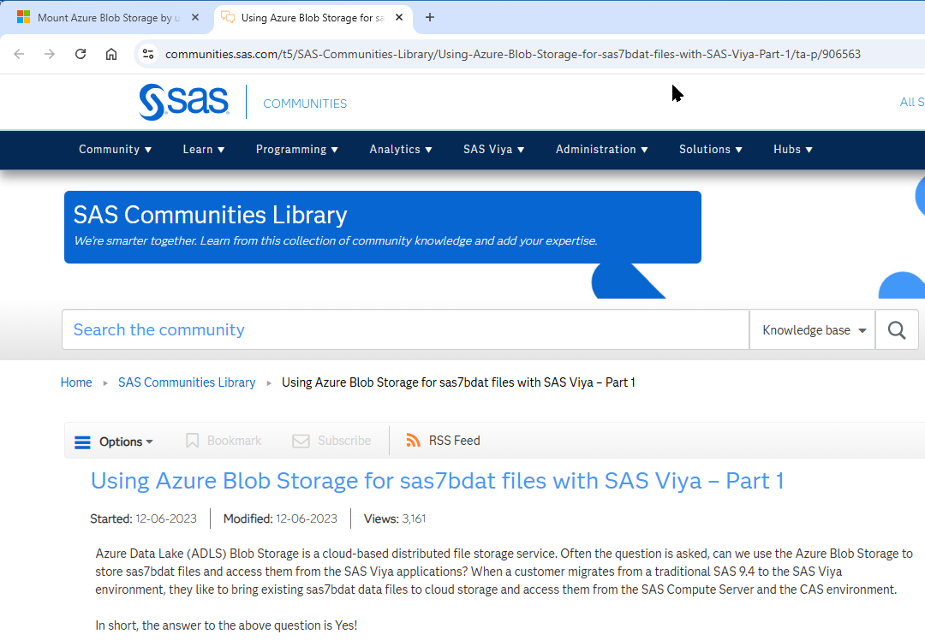
Direct Access via PVC Mount
Configuration
Various Azure Settings
Hierarchical namespace
Blob Storage interface driver
NFS 3.0
…
Azure Blob Storage Persistent Volume (PV)
Azure Blob NFS Persistent Volume Claim (PVC)

Slide 8
Direct Access via DuckDB Integration
Azure Blob
AWS S3
Google Cloud
…
libname … duckdb …;
libname z duckdb file_type=parquet
file_path="az://my_blob_storage/my_path"
azure_blob_Endpoint='https://mchn.cr.win.net'
azure_accountName='myAccountName'
azure_sas='123-byte-shared-access-secret';
CSV
Delta
DuckDB
Iceberg
JSON
Parquet
JSON
XML
CSV
SAS7BDAT
PARQUET
ORC
Image
…
Notes:
SAS also offers integration with DuckDB which can access several file types on different object storage directly.
This opens up direct access to some newer file types like Iceberg and delta lake files.
The libname syntax shown demonstrates Azure ADLS2 access. GCP access is also possible as well as S3.
DuckDB integration is a powerful addition to SAS’ capabilities and differentiates SAS from competitors by opening SAS to additional platforms and file types.

Slide 9
Object Storage Access
Azure Blob
AWS S3
Google Cloud
…
Direct Access with SAS Libraries
libname … engine …;
ORC
Parquet
caslib … srctype …;
CSV
XLS, XLSX
Parquet
ORC
…
JSON
XML
CSV
SAS7BDAT
PARQUET
ORC
Image
…
Notes:
SAS can access some file types like parquet directly from certain object storage platforms.
The fie types listed can be accessed directly from object storage using SAS libraries and CAS libraries.
Parquet and, to a lesser extent, ORC are particularly valued because of their high compression rates as well as their intelligent storage structures which can be leveraged for minimal I/O and fast processing.
These file types have their own SAS/ACCESS engines allowing direct access on several popular object storage implementations.
Check the ORC and Parquet Engines section of the SAS Viya Platform Programming documentation for the latest capabilities.

Slide 10




Macros & SAS Studio Custom Steps
Azure Blob
AWS S3
Google Cloud
…
Copy to local storage for further processing
SAS Studio Flow Custom Step
SAS Macro
%macro getfile_abs
/* Gets a file from Azure Blob Storage */
...
options azuretenantid="&azuretenantid";
filename _in abs "&abs_path.&fullfilepath."
accountname="&abs_accountname"
container="&abs_container"
applicationid="&abs_applicationID" recfm=n ;
filename _out "&fullfilepath." recfm=n lrecl=32767 ;
…
data _null_;
infile _in; file _out; input; put _infile_;
run;
...
%mend;
Niche File Types
New Types
SAS Datasets
JSON
XML
CSV
SAS7BDAT
PARQUET
ORC
Image
…
Fcopy, Proc S3, Proc HTTP, File, …
Notes:
Even without a mount, Viya can still access any file from object storage by simply copying it, temporarily, to a local file system and processing it from there.
Transferring files to the Compute and/or CAS servers’ local storage not only makes them readable but often provides processing speeds orders of magnitudes higher than what could be achieved from direct Object storage or NFS aided access.
So, it can be a good strategy whether direct reads are capable from object storage or not.
SAS has numerous strategies for transferring files including dedicated procedures like Proc S3, general procedures like Proc HTTP, as well as statements like FCOPY and the SAS File statement.
As with other strategies presented earlier, SAS provides SAS Studio Flow steps as well as pre-built SAS macros for each file type on each object storage type.
So, developers don’t have to remember or research each file access method. They can simply drag the step into their flow or call the appropriate macro with the required attributes, and the appropriate SAS code will be generated to access the files.

Slide 11

Access Object Storage files
Hands-on Exercise

Slide 12



Object storage is now accessible via PVC mount
DuckDB integration and specialized libname engines make common files directly accessible
Considerations when accessing object storage from SAS Viya
Available macros and SAS Studio custom steps make accessing object storage easy
%()

Slide 13
How Do I Modify SAS®9 Programs to Run in SAS® Viya®?

